Slide 1
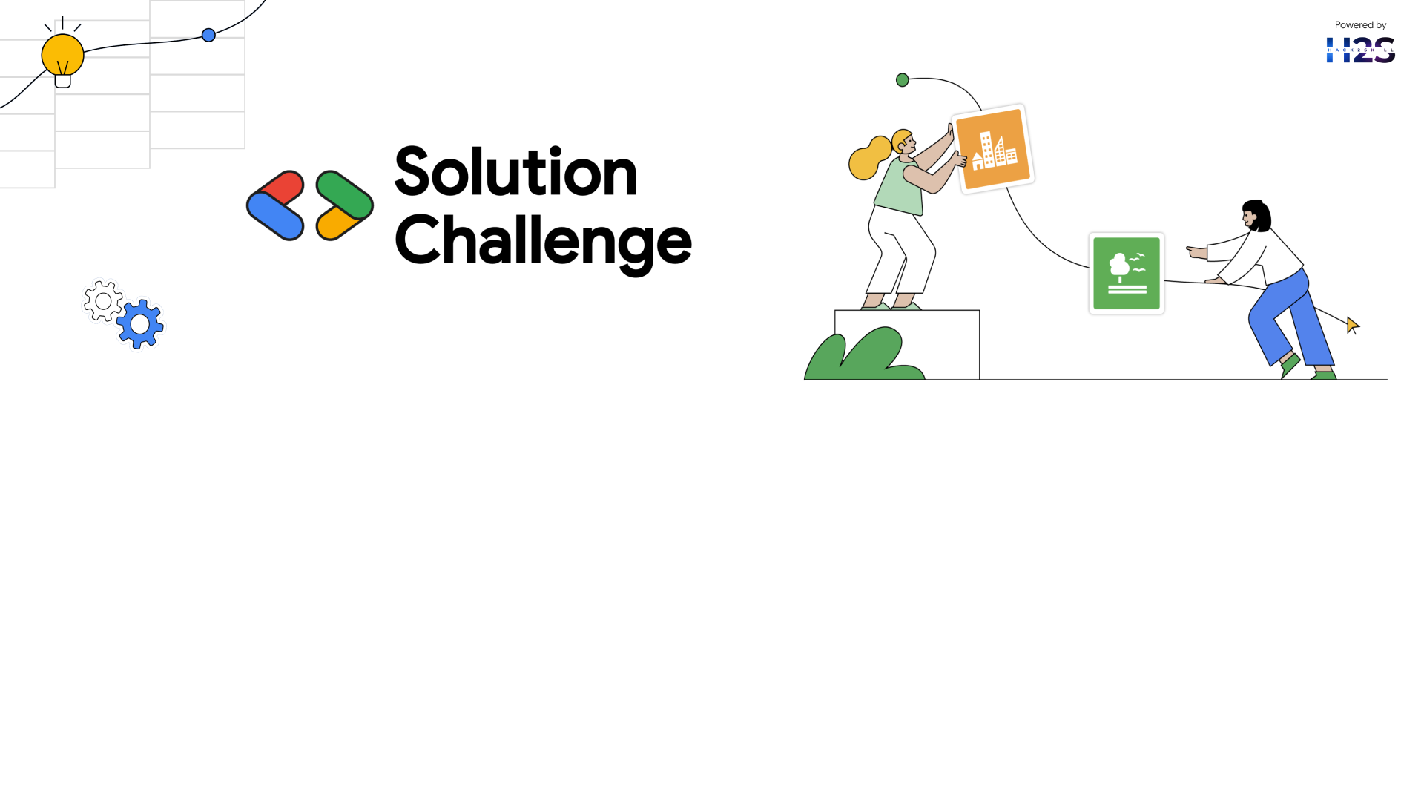
Team Details
Team name: GitGuyz
Team leader name: Vaibhav Jain
Problem Statement: Lack of Access to Healthcare in Underserved Communities

Slide 2


Bridging the Healthcare Gap with AI-Driven Solutions
AI-Driven Diagnostics & Mental Health Support
Smart Healthcare App: Developed to provide accessible and affordable medical insights.
Trained AI Model: Analyzes symptoms and provides preliminary diagnoses based on medical datasets.
Early Detection & Prevention: Helps identify health risks before they escalate.
Mental Health Assistance
AI-Based Counseling: Chatbot-guided mental health support and stress assessments.
Personalized Well-Being Plans: Tailored recommendations for mental wellness.
Community Support Feature: Connects users with support groups and professionals.
Scalable & Sustainable Approach
Offline Mode for Remote Areas: Ensures accessibility in low-connectivity regions.
Integration with Telemedicine Services: Bridges the gap between patients and healthcare professionals.
Multilingual Support: Ensures inclusivity for diverse communities.

Slide 3
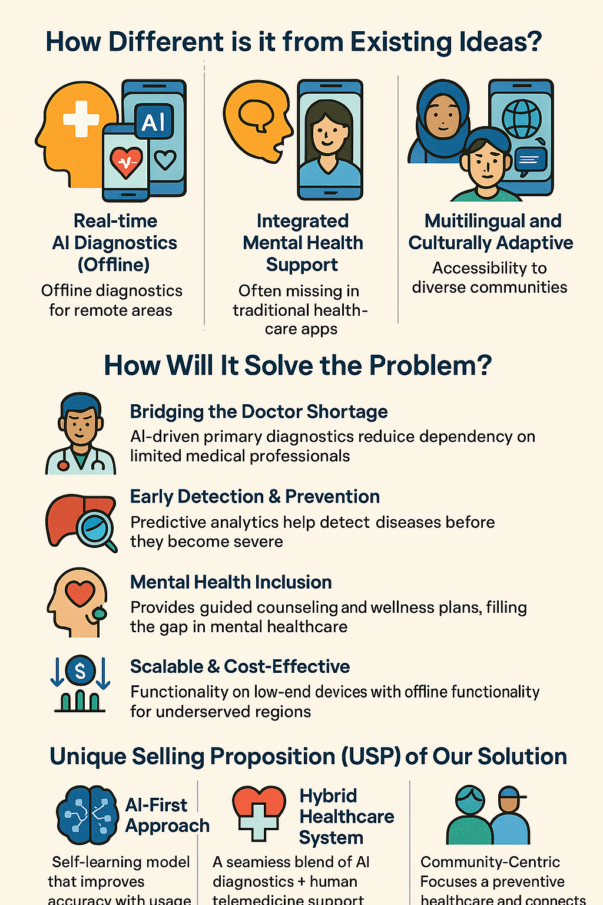
Opportunities & Unique Value of Our AI-Powered Healthcare Solution
How Different is it from Existing Ideas?
Unlike generic telemedicine platforms, our AI model provides real-time diagnostics even in offline mode for remote areas.
Integrated mental health support, which is often missing in traditional healthcare apps.
Multilingual and culturally adaptive AI, making healthcare accessible to diverse communities.
How Will It Solve the Problem?
Bridging the Doctor Shortage: AI-driven primary diagnostics reduce dependency on limited medical professionals.
Early Detection & Prevention: Predictive analytics help detect diseases before they become severe.
Mental Health Inclusion: Provides guided counseling and wellness plans, filling the gap in mental healthcare.
Scalable & Cost-Effective: Works on low-end devices with offline functionality for underserved regions.
Unique Selling Proposition (USP) of Our Solution
AI-First Approach: Self-learning model that improves accuracy with usage.
Hybrid Healthcare System: A seamless blend of AI diagnostics + human telemedicine support.
Community-Centric: Focuses on preventive healthcare and connects users with local health workers.

Slide 4
Key Features of Our Solution
🧠 AI-Powered Diagnostics
Symptom checker and preliminary diagnosis
Trained on verified medical datasets
Works even in offline mode
💬 Mental Health Support
AI-based stress and mood assessment
Chatbot for basic counseling
Personalized wellness tips
📶 Offline Functionality
Full app usability in low or no-connectivity regions
Ideal for rural and remote areas
🌐 Multilingual Interface
Supports regional languages
Inclusive design for all literacy levels
📱 User-Friendly Mobile App
Minimalist, intuitive UI
Optimized for low-end devices
🧑‍⚕️ Telemedicine Integration
Connects users with verified professionals
Appointment scheduling and follow-up reminders
📊 Health History & Insights Dashboard
Tracks vitals, diagnosis history, and mood patterns
Visual summaries to help users monitor their well-being
👥 Community & Peer Support
Join groups based on common health goals or conditions
Localized forums and helplines

Slide 5
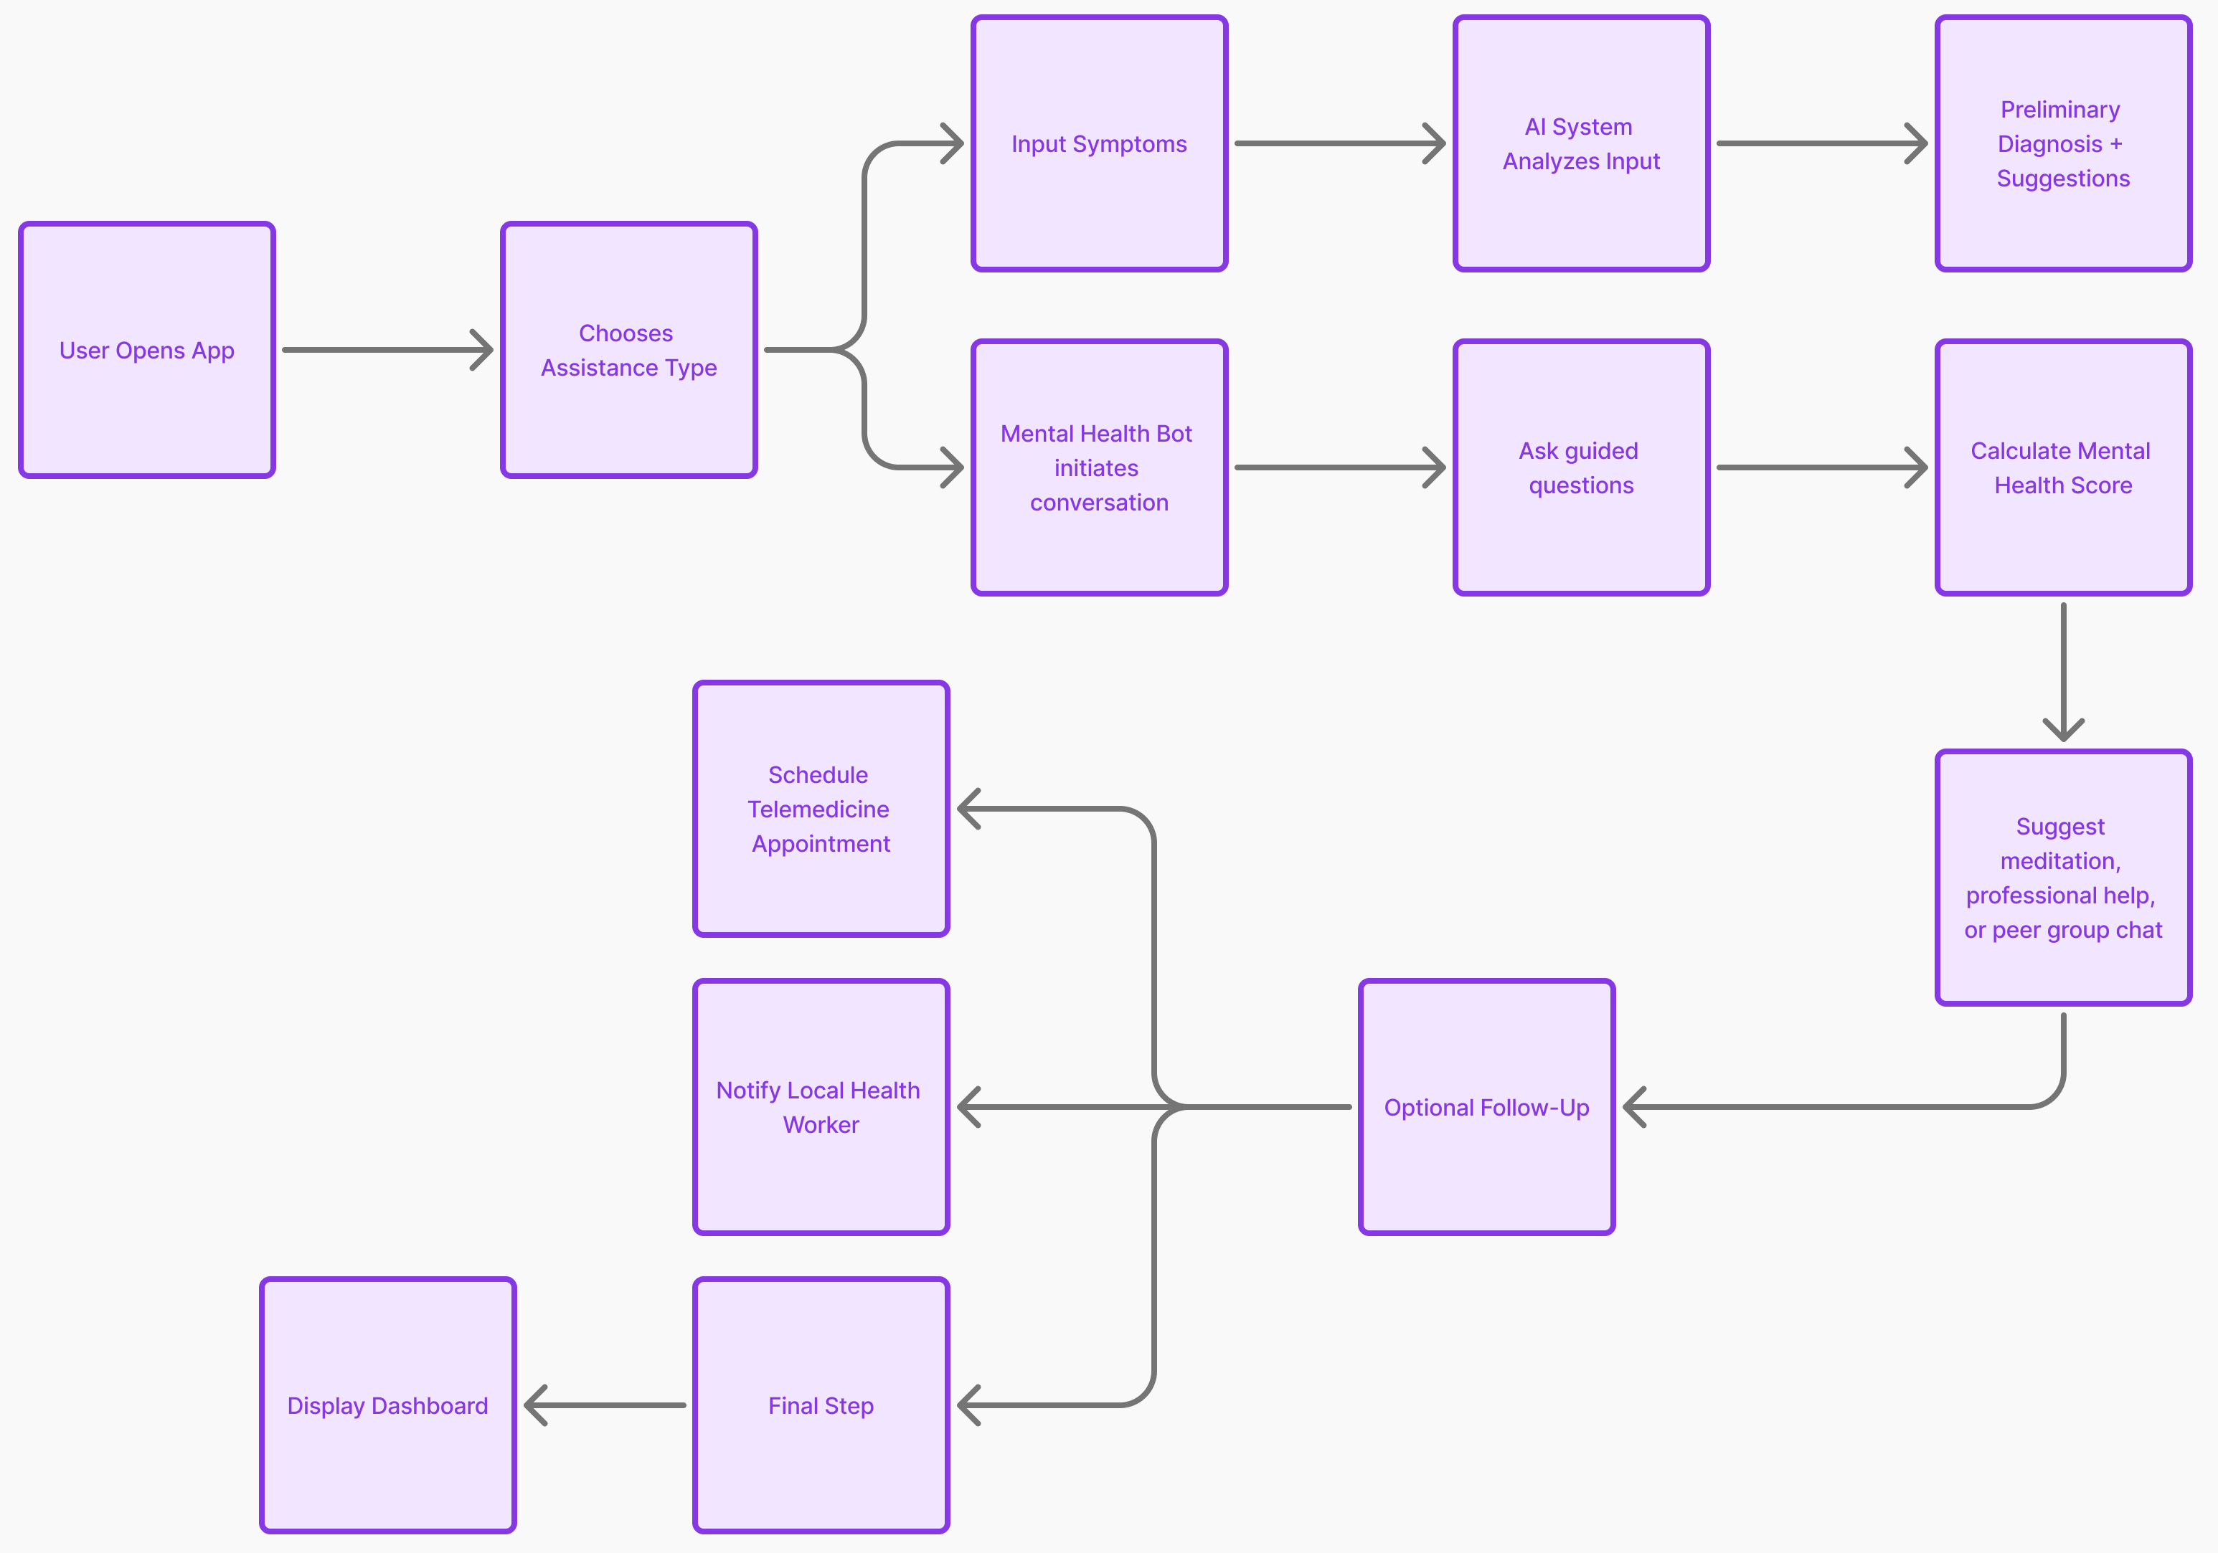
Process flow diagram

Slide 6
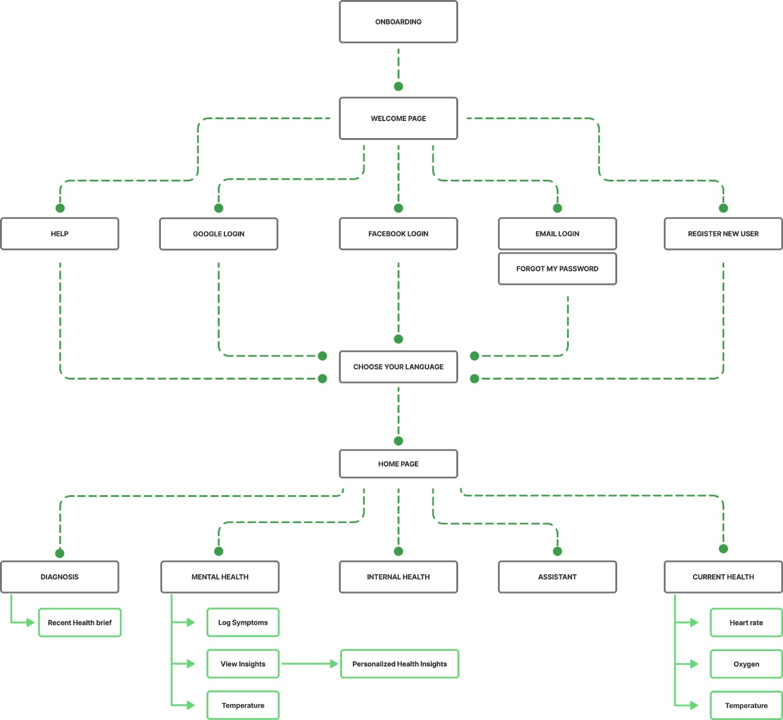
Architecture Diagram

Slide 7
Technologies Used in the MVP
AI & ML
Gemini API (by Google):
Powers conversational AI for mental health support
Handles natural language processing for multilingual and empathetic replies
Custom ML Models:
Trained on medical datasets for symptom-based diagnostics
PyTorch used for model development
Transformers for Natural Language Processing
speech_recognition for speech to text
Frontend & Mobile App Development
Flutter (Dart):
Cross-platform mobile app (Android + iOS)
Fast development with a single codebase
Figma:
UI/UX design, wireframing, and prototyping
Used for team collaboration on design workflow
Backend & APIs
Firebase:
Authentication, real-time database, and cloud functions
Gemini AI Integration:
Mental health chatbot and real-time symptom analysis

Slide 8
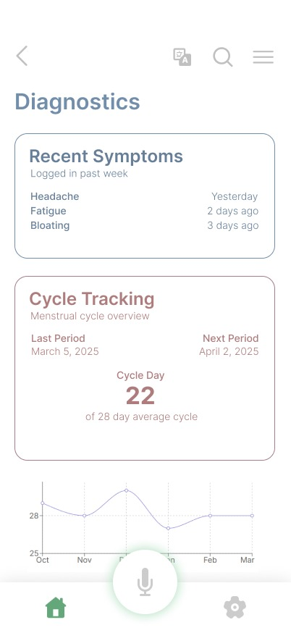
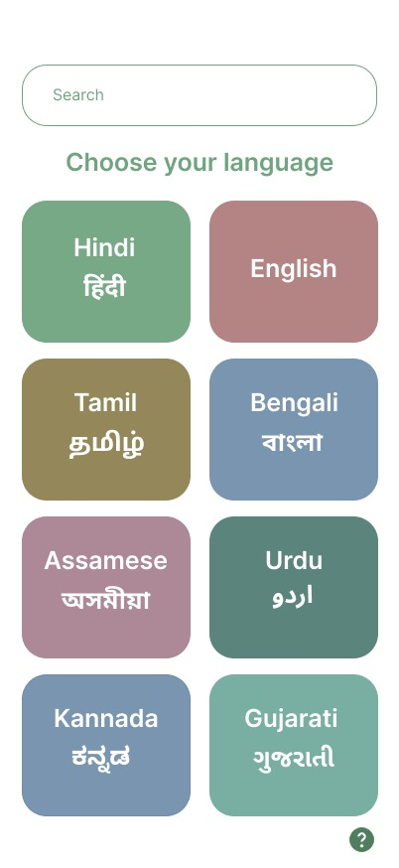
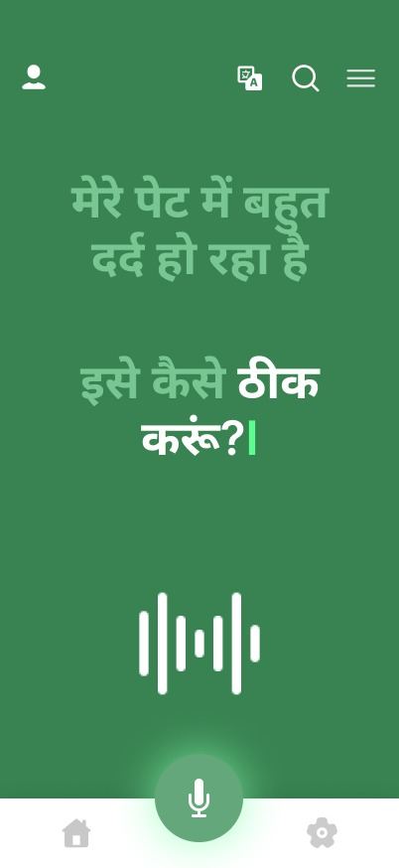
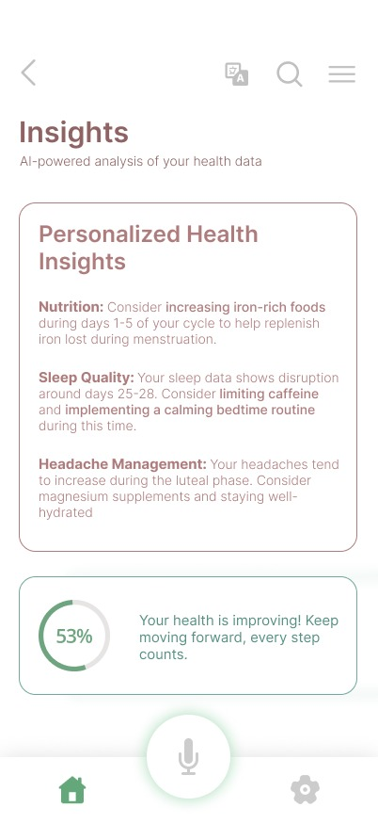
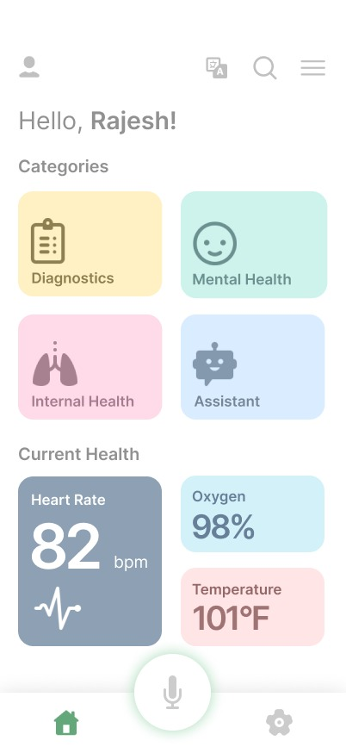
Snapshots of the MVP

Slide 9
Provide links to your:
GitHub Public Repository : Github Link
Demo Video Link (3 Minutes) : Video Link
MVP Link: MVP link

Slide 10
